Slide 1
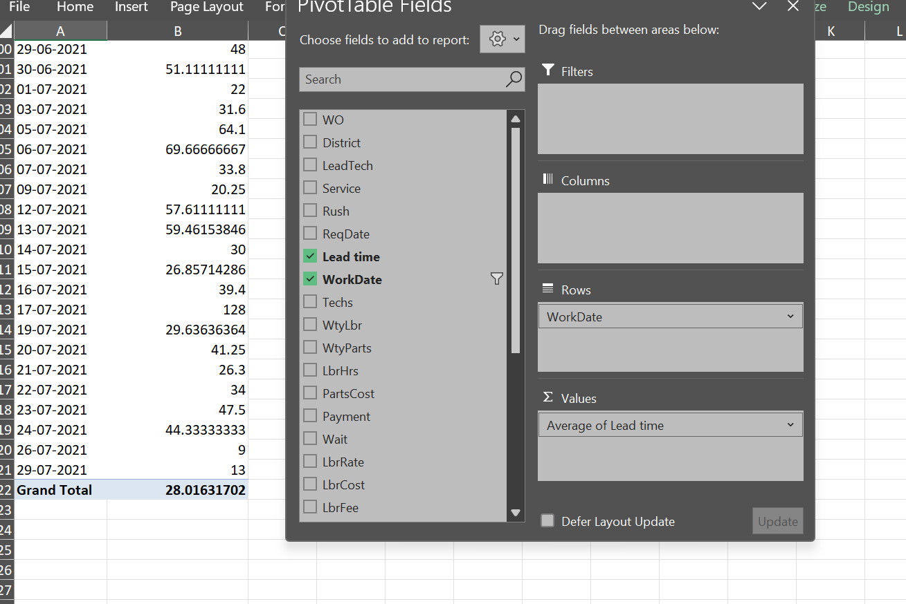
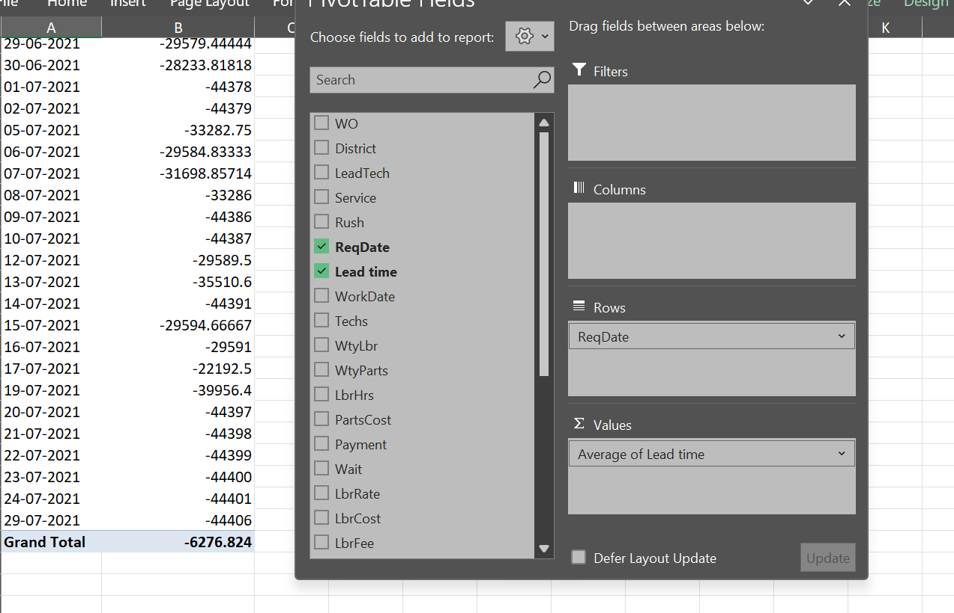
Task1: Average lead time between the request date(ReqDate) and completion Date(WorkDate) for all work orders
Both the images attached display the calculation of Average of Lead Dates with respect to Request Date and Completion Date Respectively.

Slide 2
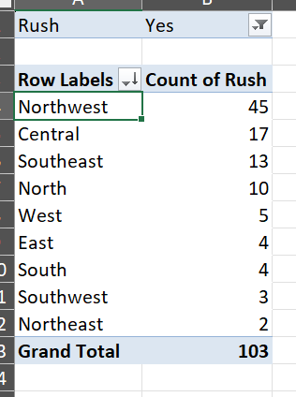
Task2: Which District has the highest number of rush jobs
Filtered all the jobs with Rush value = “Yes”
Added District in rows and Calculated count of rush for all the districts
Northwest has highest no. of Rush Jobs.

Slide 3
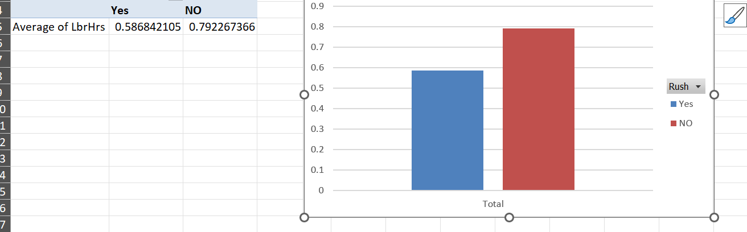
Task3: How does the average labour hours(LbHrs) differ between Rush and non Rush jobs.
Kept Rush hours values in Column and calculated average of rush hours in each scenario.
Job hours with no Rush have high Labour Hours.

Slide 4
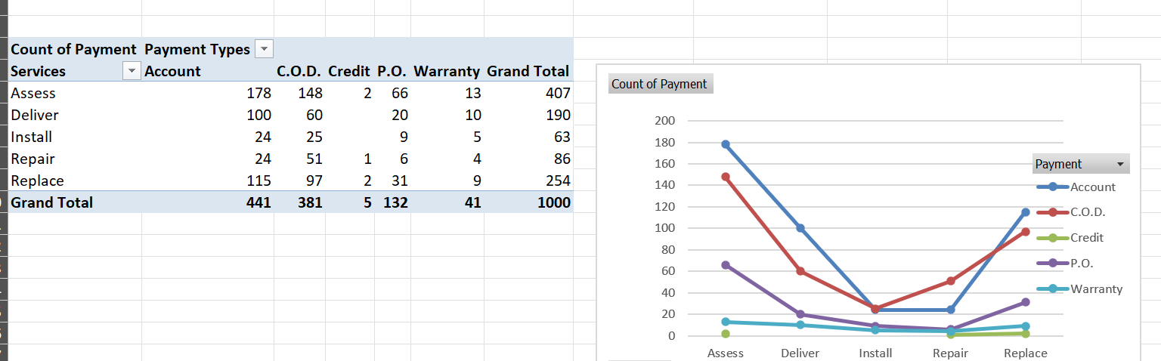
Task 4: What is the distribution of payment types across different services.
Kept all services in rows
Kept all payment types in columns
Calculated count of payment types for the matrix.
The graph displays the trend of payment types for different services.

Slide 5
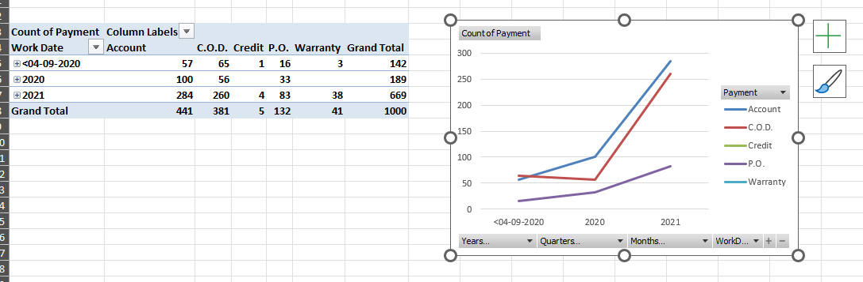
Task 5: Are there any trends in the distribution of payment types across time.
The trend shows rise in use of different payment types over the years.
With a sudden rise in use of COD mode of payment.

Slide 6
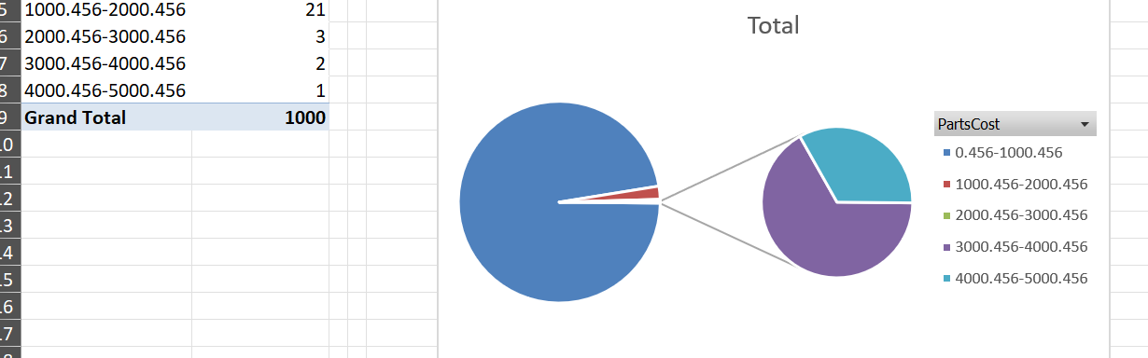
Task 6: Is there any relationship between number of technicians required and the cost of parts.
According to my analysis, most of the technicians tend to handle those cases which have less cost of parts of equipments.
Only few Technicians take risk of handling expensive parts of equipments.

Slide 7
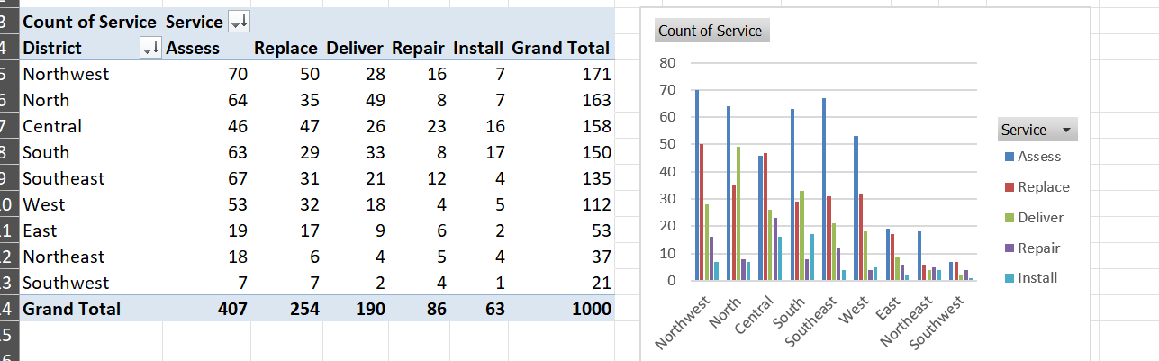
Task 7: Most common type of service requested in each district.
After my analysis I found that most of the districts use Assistance service and replacement service most of the times around all the Districts.
Calculated by putting Districts in columns and Services types and their count in rows.

Slide 8
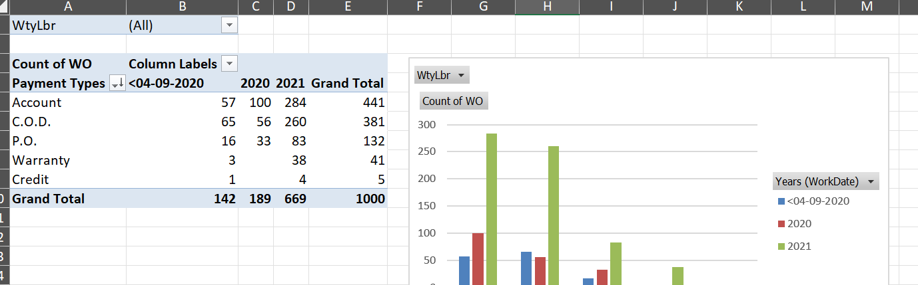
Task 8: Is there any difference in the distribution of payment types in work orderswith warranty labour compared to those without it.
There are very less amount of jobs with Warranty labour.
Most of the jobs with warranty labour tend to take their payment sin Account only.
And by the years, the count of warranty labours is increasing.

Slide 9
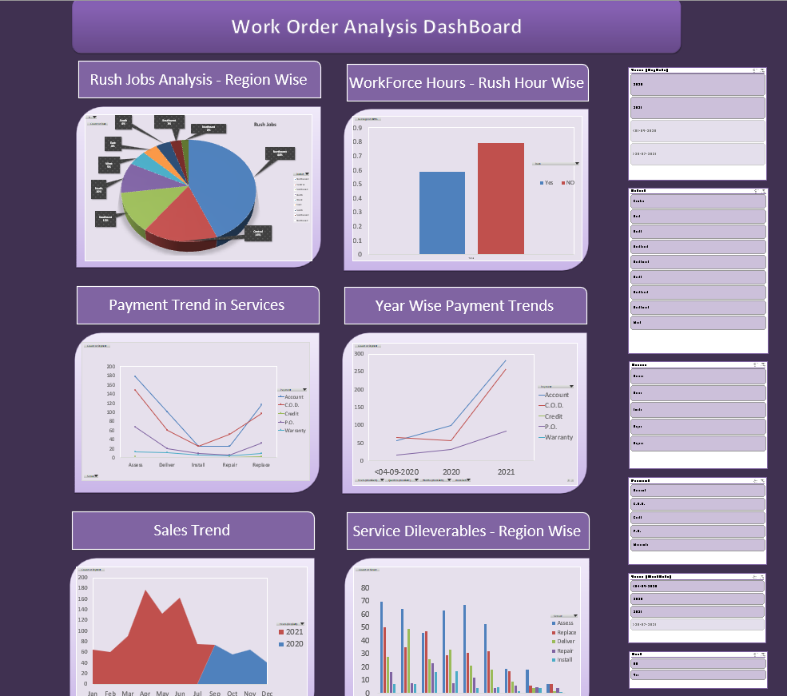
DASHBOARD SNAP - 1

Slide 10
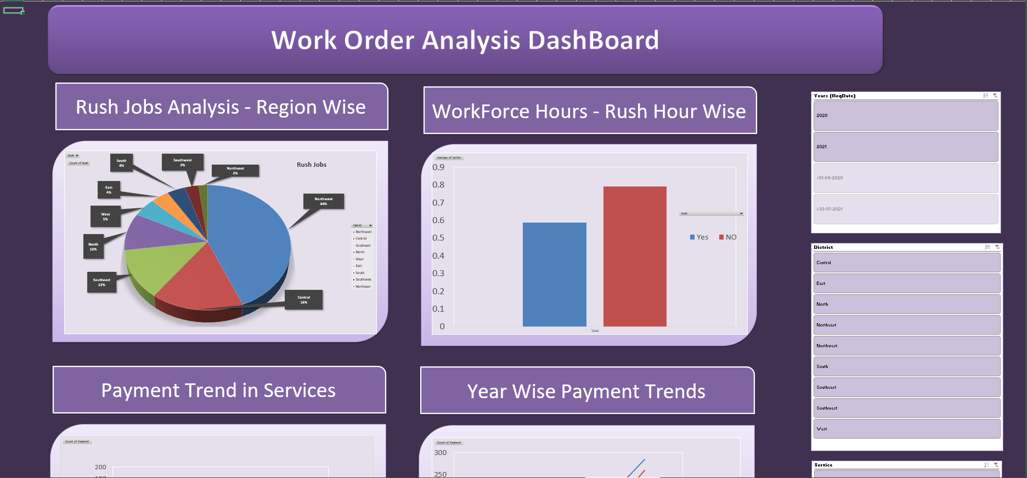
DASHBOARD SNAP – 2

Slide 11
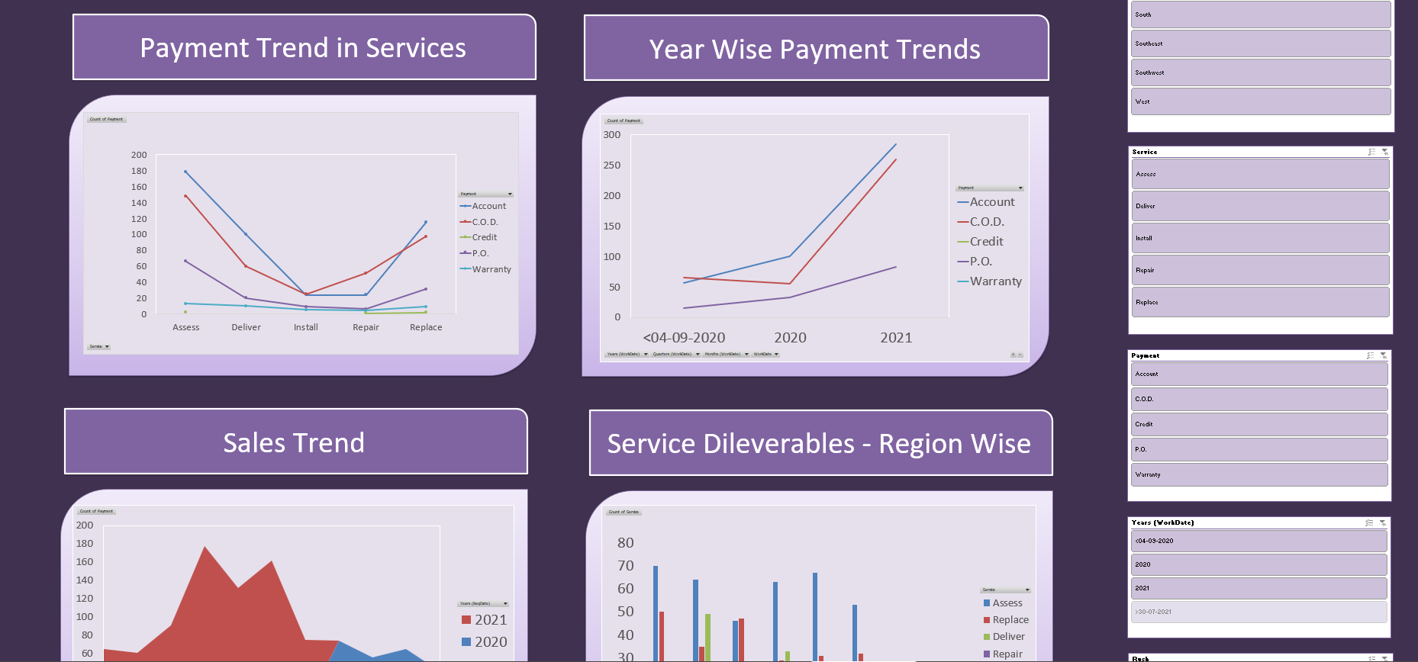
DASHBOARD SNAP – 3

Slide 12
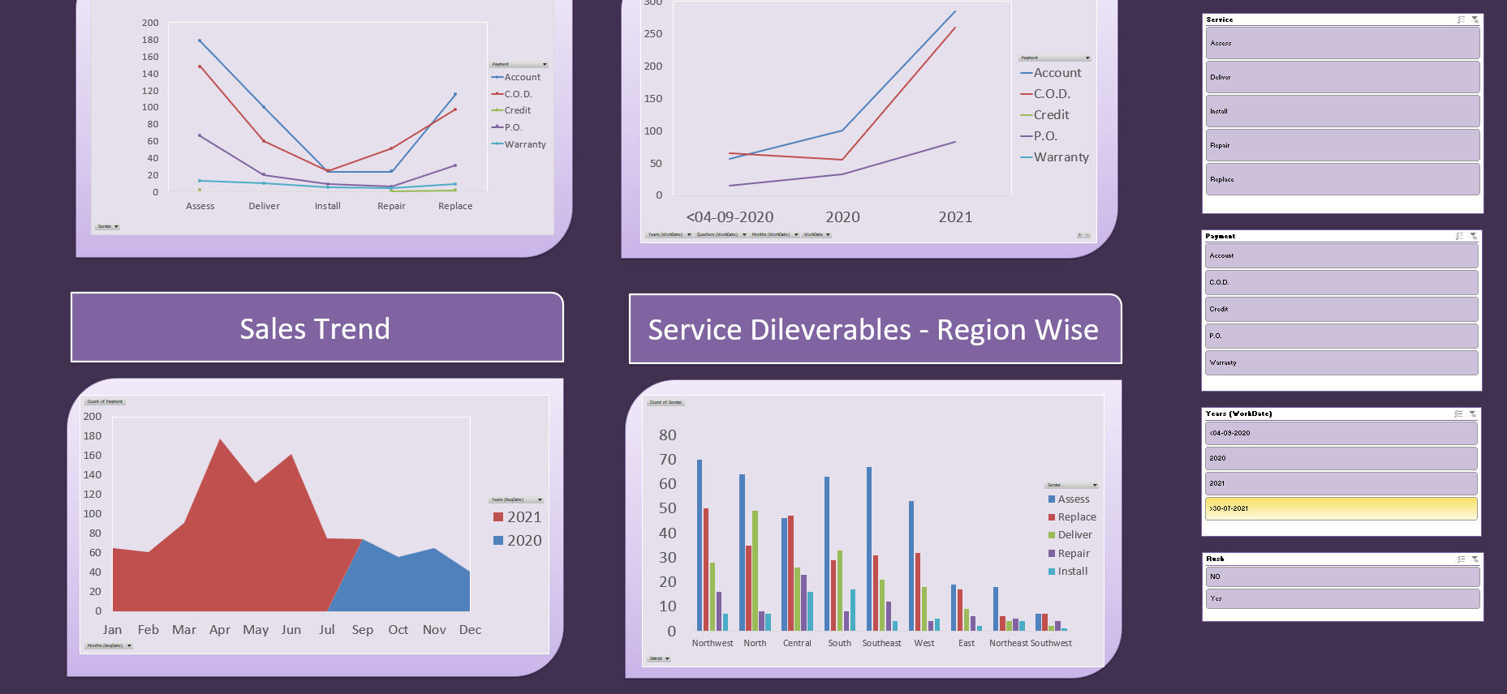
DASHBOARD SNAP – 4

